Slide 1
The City Builds The City:
A Pan-Canadian Public Builder Model
Halima Ali, Matthew Chasmar, Jacob VanHelder, Andre Fajardo
March 18th, 2024

Slide 2
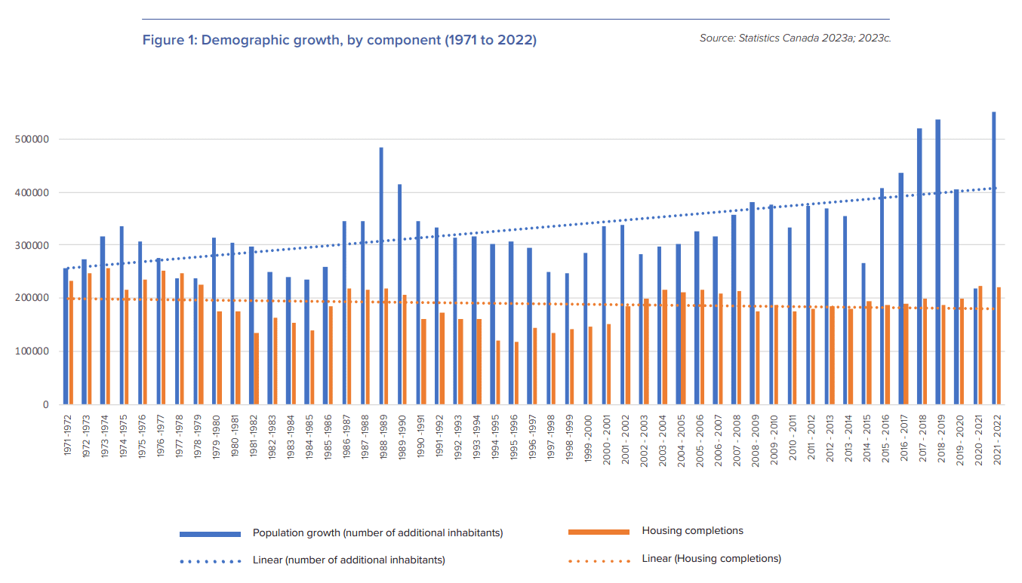
The Canadian Housing Crisis
Canada’s population has been growing for decades, and the construction of market-rate housing has not kept up (Macdonald-Laurier Institute, 2023)
Private developers deterred from building, or incentivized to build the “wrong” kinds of housing.
Investment in social housing has been similarly insufficient (FCM, 2016)
Federal government retreated from funding social housing in the 1990s, as did many Provinces.
Numerous previously-built social housing units have closed as operating agreements expire.
Notes:
MacDonald Laurier Institute:
https://macdonaldlaurier.ca/getting-our-houses-in-order-how-a-lack-of-intergovernmental-policy-coordination-undermines-housing-affordability-in-canada/
Number of new inhabitants each year has on average grown from under 300,000 in the 1970s, to an average just under 400,000 today.
Housing completions have actually decreased on average over the same period.
https://www.theglobeandmail.com/opinion/article-canada-needs-a-new-national-housing-program/
https://fcm.ca/sites/default/files/documents/resources/submission/canada-housing-opportunity.pdf

Slide 3
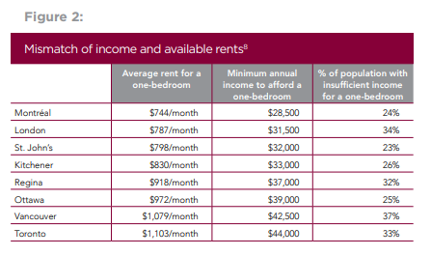
The Canadian Housing Crisis: A Case of Market Failure
Everyone pays more for housing, while the most vulnerable struggle to find it altogether.
Largest gap between home prices and incomes in the G7 (2023); social housing waitlists “intolerably long,” average 4 years in Ontario (2016).
Toronto provides one snapshot of this crisis:
Median rent of $2,696, 38% higher than the national average (2024).
Home prices growing 4x faster than income growth, while rental costs grow 2x faster (2020); 97,000 households waiting for social housing (2016).
Growing homelessness: 11,173 “actively homeless in February 2024, compared to 8,132 in February 2018.
Notes:
https://www.zumper.com/rent-research/toronto-on
https://www.torontomu.ca/content/dam/social-innovation/Programs/Affordable_Housing_Visual_Systems_Map_Oxford.pdf
https://www.toronto.ca/city-government/data-research-maps/research-reports/housing-and-homelessness-research-and-reports/shelter-system-flow-data/

Slide 4
Our Recommendation: Bring the City Back Into Housing
A Federally-Supported, Locally-Led Public Builder Model with a Focus on Affordable Rental Housing.

Slide 5
Jurisdictional Scan: Vienna, Austria
Municipal-Led Development: Vienna's government takes the lead in housing development, actively identifying sites and managing the process.
Mixed-Income Communities: Vienna prioritizes mixed-income communities, ensuring diverse housing options within developments.
Rents are capped at a percentage of household income, ensuring affordability for residents.
Direct Construction Contracts: The city directly contracts construction companies, ensuring quality and adherence to standards.
Notes:
In Vienna, the government plays a central role in housing development through a Municipal-Led Development approach, actively identifying sites and managing the process. This ensures strategic and efficient use of resources. Additionally, Vienna prioritizes Mixed-Income Communities, offering diverse housing options within developments to promote social integration and economic diversity. Moreover, the implementation of Rent Caps based on household income ensures housing affordability, contributing to inclusive urban growth. Finally, the city directly contracts construction companies, ensuring high-quality standards and adherence to regulations, fostering accountability and efficiency in the construction process.

Slide 6
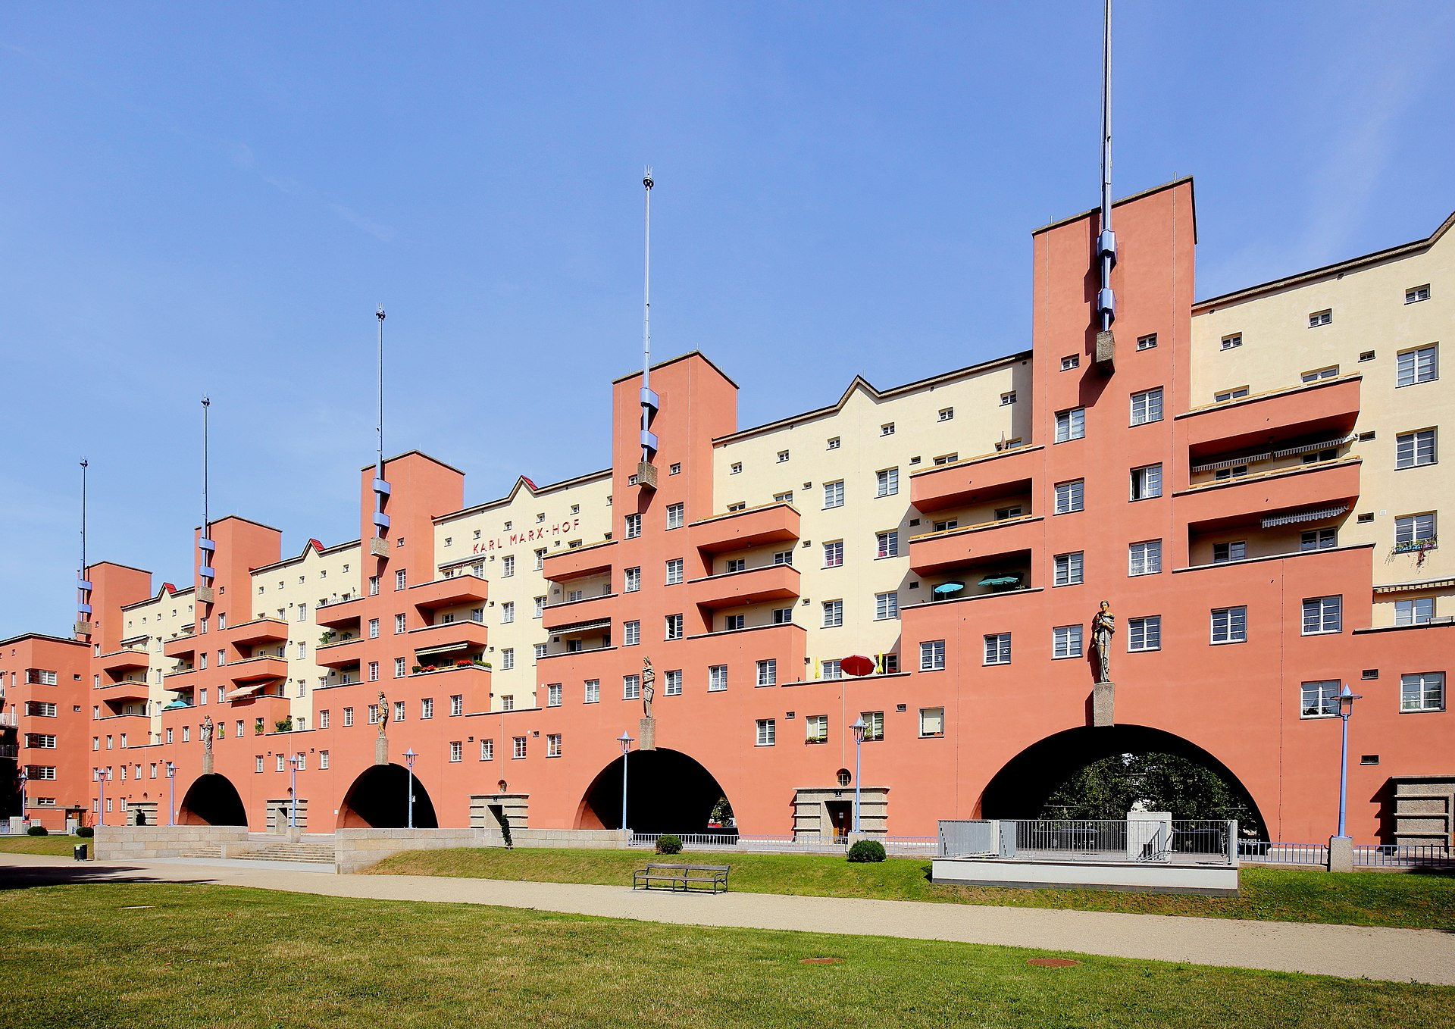
Jurisdictional Scan: Vienna, Austria
Public Ownership and Management: Housing developments are often publicly owned and managed, providing stability and oversight.
Community Engagement: Vienna engages communities in the development process, fostering a sense of ownership and inclusion.
Notes:
Vienna emphasizes Public Ownership and Management of housing developments, ensuring stability and oversight in the housing sector. Additionally, the city prioritizes Community Engagement, involving residents in the development process to foster a sense of ownership and inclusion, ultimately enhancing the quality and responsiveness of urban development initiatives.

Slide 7
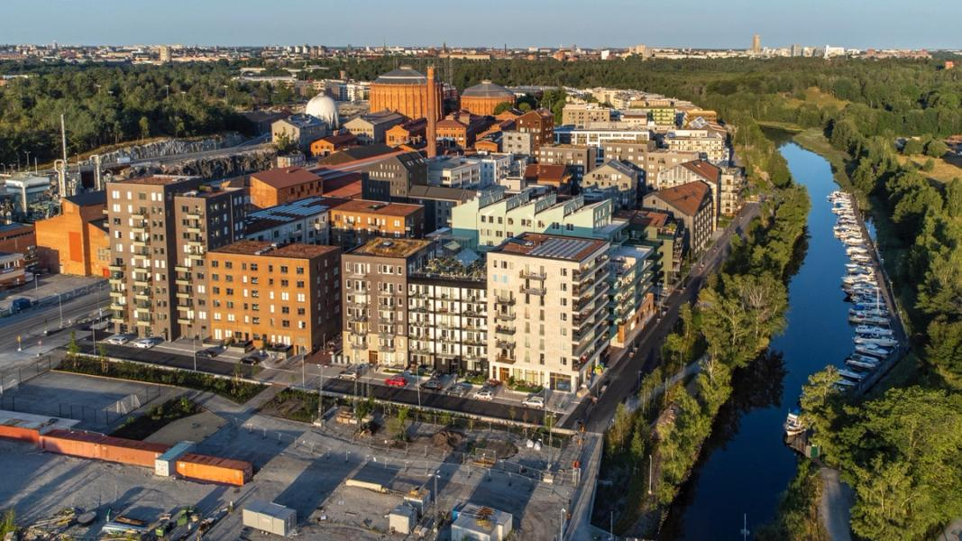
Jurisdictional Scan: Stockholm, Sweden
Stockholm Royal Seaport, Sweden: A large-scale urban development initiative led by the City of Stockholm, emphasizing sustainability, innovation, and equity.
Key Features: Incorporates mixed-use developments, green spaces, and sustainable transportation solutions, serving as a platform for urban experimentation.
Sustainability Goals: Aims to be one of the world's most sustainable urban districts, integrating renewable energy, efficient water management, and ambitious environmental targets.
Notes:
Stockholm Royal Seaport is a large-scale urban development initiative led by the City of Stockholm, emphasizing sustainability, innovation, and equity. It incorporates mixed-use developments, green spaces, and sustainable transportation solutions, serving as a platform for urban experimentation. With ambitious sustainability goals aiming to be one of the world's most sustainable urban districts, Stockholm Royal Seaport integrates renewable energy, efficient water management, and environmental targets.

Slide 8
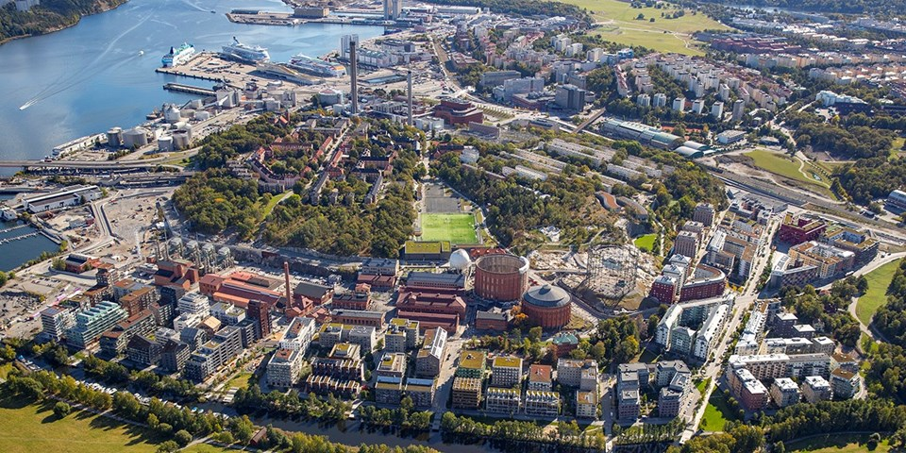
Jurisdictional Scan: Stockholm, Sweden
Equity Focus: Prioritizes social inclusion, affordable housing, and accessibility, with a diverse mix of housing types and public amenities to promote social cohesion.
Relevance: Offers valuable lessons for expanding Toronto's public-builder model to other Canadian cities, providing a replicable model for balancing urban development with sustainability and equity objectives.
Notes:
Furthermore, its Equity Focus prioritizes social inclusion, affordable housing, and accessibility through a diverse mix of housing types and public amenities, promoting social cohesion. Its relevance lies in offering valuable lessons for expanding Toronto's public-builder model to other Canadian cities, providing a replicable framework for balancing urban development with sustainability and equity objectives nationwide.

Slide 9
Closer to Home: Toronto’s City Led Development Model
65,000 new units promised by 2030
How Many?
1
How?
The city, as the public builder, identifies, re-zones, and contracts out new residential construction on municipally owned sites.
2
Who?
3
Building operators and management will be contracted out by the city, but not-for-profit operators are heavily sought and prioritized.

Slide 10
Impact and Timeline
Report for Action Presented, Federal funding obtained
2023
Multi-level stakeholder engagement/consultation
2024
Next Federal, Provincial and Municipal Elections
2025/2026
HousingTO Target: 65,000 new rent-controlled homes
2030
Notes:
2023:
Plan was announced Oct 7th 2023, presented to Council
Generational Transformation of Toronto’s Housing System to Urgently Build More Affordable Homes
Bulding on HousingTO 2020-2030 Action Plan - especially in building more affordable rental
2024:
staff will undertake the following activities and
report back in 2024:
• engage with the federal and provincial governments, Indigenous organizations,
non-profit and co-op housing organizations, financiers, academic institutions,
philanthropic organizations and private sector organizations (including large
employers), to explore the establishment of a sustainable fund to support new
development;
• engage with United Way Greater Toronto to explore partnership opportunities
that support non-profit led affordable housing development and acquisition
projects and create new affordable and RGI homes, with a particular focus
on community service infrastructure;
• consider existing City sources of funds (e.g. Community Benefits Charge) to
support the above;
• review Toronto Community Housing Revitalization program and identify
opportunities to improve program viability while optimizing city-building
opportunities; and
• consider other planning tools as appropriate (e.g. increased zoning permissions
to add height and density to support delivery of the affordable and RGI
component of projects)
Target by 2030 as set out by HousingTO:
65,000 new rent-controlled homes
Including 6,500 RGI (rent-geared-to-income) homes
And 18,000 supportive homes with a focus on helping people exit homelessness

Slide 11
Benefits of a Public Builder Initiative
High level of public control
Ownership agreements can carry stipulations, including the prioritization of tenancy for at-risk populations
Progressive growth of housing stock
With public control and tighter levers for affordability concerns, these will be stable additions to the housing stock
Faster bureaucratic process
Land, zoning, and approval processes can be fast-tracked
Flexible to experimentation and learning
Pace of construction also allows for engagement with research institutions and universities to adapt and learn over the initiative

Slide 12
Challenges and Considerations
High Cost
Medium - High Risk absorption
Without significant contributions from other levels of government smaller municipalities are locked out.
City will absorb financial risk of construction costs.
Exact Long Term risk is unclear as ownership model is still being developed.
Significant Operating Capacity
Requires high level of interdepartmental alignment and large bureaucratic resource allocations

Slide 13
Equity, Sustainability, and Learning
Learning for Housing, and Recognizing the Value of New Knowledge
Universities, research institutions, non-profits are valuable sources of new knowledge.
‘Living lab’ practices - openness to adaptation and experimentation when designing and building housing - should be encouraged with public ownership.
Reinforcing Canadian Values of Diversity and Inclusivity
By integrating elements of affordability, sustainability, and equity, this approach ensures that housing developments accommodate diverse socioeconomic backgrounds while mitigating environmental impacts.

Slide 14
Thank you!
Any questions?

Slide 15
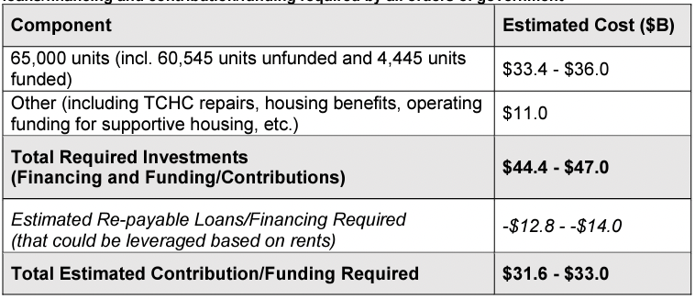
Appendix:
Total Estimated Cost

Slide 16
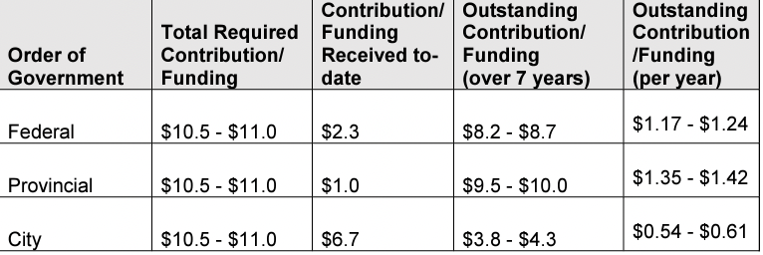
Appendix:
Total Intergovernmental Contributions

Slide 17
Why Vienna and Stockholm Models Would Work For Cities across Canada
Vienna's municipal-led approach and rent cap model offer strategies for addressing housing affordability challenges in cities across Canada.
Stockholm Royal Seaport's sustainability goals and equity focus provide valuable insights for urban development initiatives in Canadian cities.
Both models emphasize community engagement, fostering a sense of ownership and inclusivity among residents in cities across Canada.
Lessons from Vienna and Stockholm Royal Seaport offer replicable models that align with the commitment to sustainability and equity objectives in cities across Canada.
Adapting elements of these models can help Canadian cities create more inclusive, sustainable, and resilient communities for their residents.
Notes:
Despite their differences, both Vienna and Stockholm Royal Seaport offer valuable insights that can inform urban development strategies in Toronto. Here's why elements of these models could work in Toronto:
Public-Led Approach: Leveraging municipal resources and authority, cities across Canada can adopt Vienna's model to actively guide housing development. Mixed-Income Communities: Embracing mixed-income communities promotes social integration and economic diversity, benefiting diverse populations across Canadian cities. Affordable Housing Solutions: Applying Vienna's rent cap model addresses affordability challenges, ensuring housing remains accessible in cities nationwide. Community Engagement: Incorporating Vienna's community engagement practices fosters a sense of ownership and inclusivity among residents, enhancing urban development processes across Canada. Sustainability Goals: Stockholm Royal Seaport's innovative approaches offer strategies for achieving sustainability targets set by cities nationwide. Equity Focus: Aligning with growing concerns about social equity and affordable housing, Stockholm Royal Seaport's equity objectives provide valuable insights for Canadian cities. Lessons for Expansion: Both models offer replicable strategies for urban development, providing valuable lessons for scaling up public-builder models while balancing sustainability and equity objectives across Canada.
While Vienna and Stockholm Royal Seaport have unique characteristics, their underlying principles of sustainability, equity, and community engagement hold relevance for Toronto's urban development challenges. By adapting and integrating elements of these models into Toronto's context, the city can work towards creating more inclusive, sustainable, and resilient communities for its residents.

Slide 18
Advancing Housing Sustainability and Equity Across Canada
Expanding Toronto’s public-builder model to more Canadian cities, combined with urban experimentation, promises to alleviate the housing crisis by offering affordable, sustainable, and inclusive housing solutions
By integrating elements of affordability, sustainability, and equity, this approach ensures that housing developments accommodate diverse socioeconomic backgrounds while mitigating environmental impacts.
Drawing from successful international models like Vienna and Stockholm Royal Seaport, cities can tailor strategies to their unique contexts, fostering resilient and vibrant communities nationwide.
Notes:
Expanding Toronto’s public-builder model to more Canadian cities, coupled with elements of urban experimentation, holds significant potential to improve sustainability and equity in addressing the housing crisis across the country. Here's how:
Affordability Solutions: Toronto's public-builder model emphasizes affordable housing solutions, such as rent caps and mixed-income communities. By expanding this model to other cities, particularly those facing similar affordability challenges, it ensures that housing remains accessible to a diverse range of income levels, mitigating the impacts of the housing crisis on vulnerable populations.
Sustainability Goals: Incorporating elements of urban experimentation allows for the implementation of innovative sustainability measures in housing developments. This includes integrating renewable energy sources, implementing green building practices, and promoting sustainable transportation solutions. By aligning with sustainability goals, the expanded public-builder model contributes to reducing carbon emissions, conserving resources, and creating healthier, more resilient communities across Canada.
Equity and Inclusion: The public-builder model prioritizes equity and inclusion by fostering mixed-income communities and promoting social integration. By expanding this model to more Canadian cities, it ensures that housing developments are designed to accommodate diverse socioeconomic backgrounds, reducing segregation and promoting social cohesion. Additionally, community engagement practices ensure that residents have a voice in the development process, fostering a sense of ownership and inclusivity.
Replicability and Scalability: Toronto's public-builder model, coupled with elements of urban experimentation, offers replicable and scalable solutions that can be adapted to different contexts and challenges across Canada. By learning from Toronto's experiences and incorporating lessons from successful international models like Vienna and Stockholm Royal Seaport, cities can tailor housing development strategies to their unique needs while upholding principles of sustainability and equity.
In summary, expanding Toronto’s public-builder model to more Canadian cities, alongside elements of urban experimentation, presents an opportunity to address the housing crisis by providing affordable, sustainable, and inclusive housing solutions. By prioritizing affordability, sustainability, and equity, cities can work towards creating thriving communities where all residents have access to safe, affordable housing and opportunities for prosperity.

Slide 19
Toronto’s “City Led Development” Model
Key Features:
City will act as a public builder (developer) managing each stage of development:
The city identifies “Housing Ready” sites on municipally owned lands.
Construction companies will be contracted by the City.
City Led not City Owned.
Building operators and Owners will be assigned by the City.
Not-for profit are operators are selected for ownership.
Promised Outcomes:
65,000 units
Cost and Delivery Network:
Costs:
$31.6B - $33B over 7 years
Delivery Network:
Joint delivery headed by Toronto Community housing and Create TO
Various housing agencies and partners.
Provincial and Federal Government funding required

Slide 20
Weighing Challenges of a City Led Development Model in Canada
Benefits:
High Level of Control
Ownership agreements can carry stipulations:
Prioritize tenancy to at-risk populations.
Mandate levels of affordability
Tailor development and affordability type to fit reflect broader municipal goals
Fast
Expedited land acquisition phase
Leverage existing municipally owned land for site selections.
Expedited zoning and approval process.
No need for council approval
Ensures committed housing stock growth
Less reliance on market fluctuations.
Draw-Backs:
Medium - High Absorption of Risk:
Exact risk is unclear as ownership model are still being developed
High Cost:
Without significant investment from other levels of government, smaller municipalities are locked out.
Requires significant operating capacity
High level of resource allocation
Large bureaucracy requirements
Requires high level of interdepartmental coordination.

